Slide 1
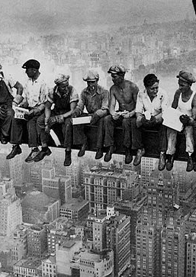
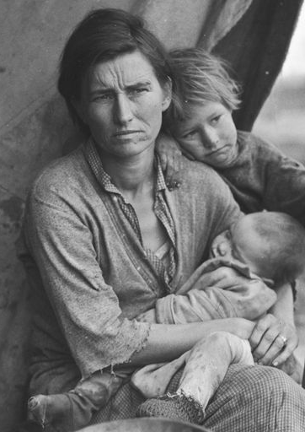
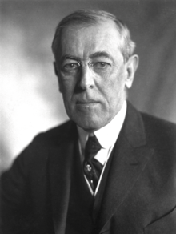
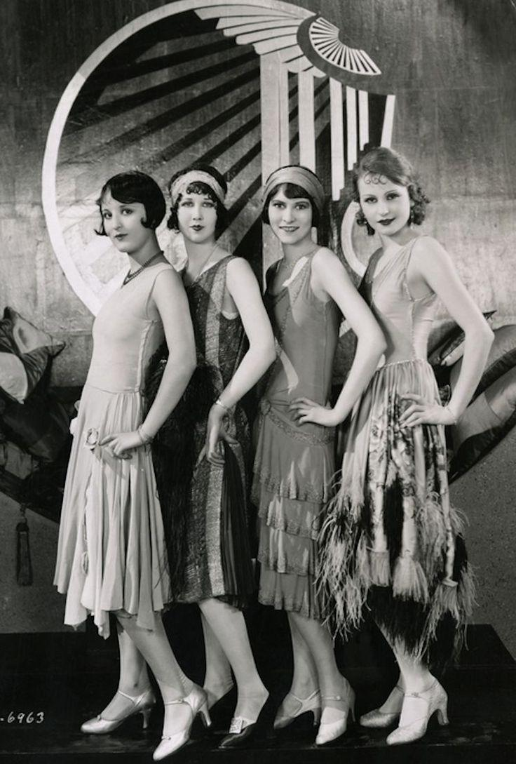
Year 11 Modern History
Unit 1: Elective 7
Capitalism – an American experience 1907-1941

Slide 2

MY expectations
Behaviour
Assessment policy
Reading schedule

Slide 3
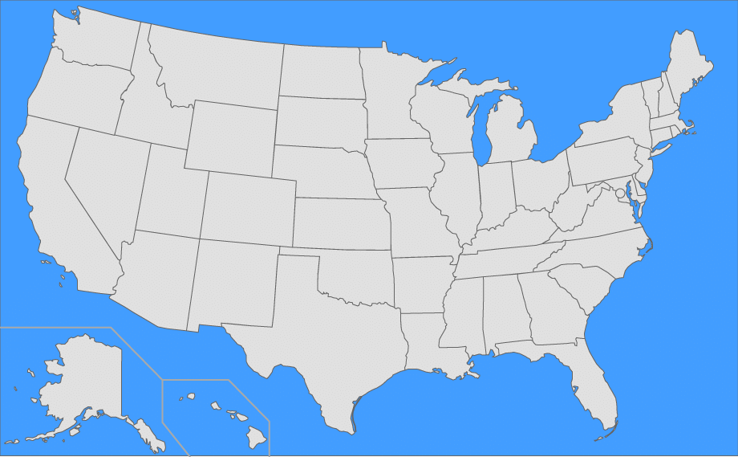
Can you list all 50 states of the USA?!

Slide 4
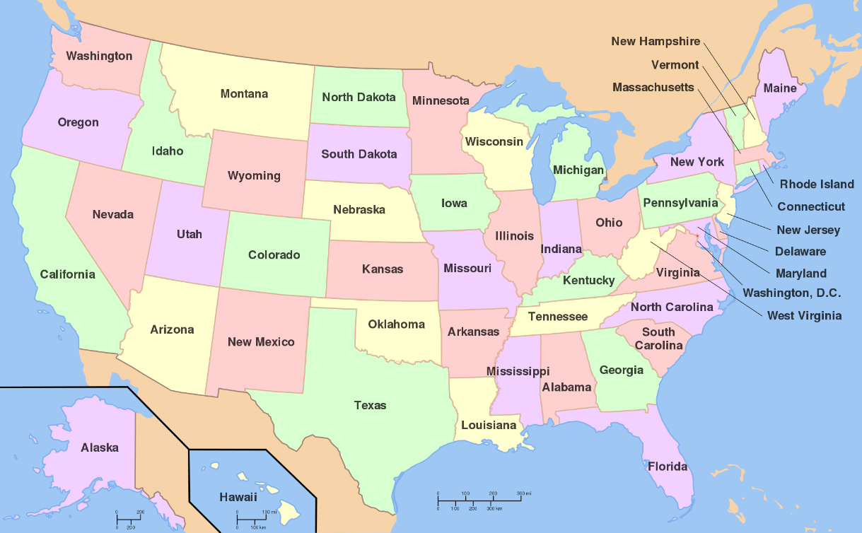
States of USA
Alabama
Alaska
Arizona
Arkansas
California
Colorado
Connecticut
Delaware
Florida
Georgia
Hawaii
Idaho
Illinois Indiana
Iowa
Kansas
Kentucky
Louisiana
Maine
Maryland
Massachusetts
Michigan
Minnesota
Mississippi
Missouri
Montana Nebraska
Nevada
New Hampshire
New Jersey
New Mexico
New York
North Carolina
North Dakota
Ohio
Oklahoma
Oregon
Pennsylvania Rhode Island
South Carolina
South Dakota
Tennessee
Texas
Utah
Vermont
Virginia
Washington
West Virginia
Wisconsin
Wyoming

Slide 5

Rationale (why are we studying this?)
Why study history? https://www.youtube.com/watch?v=gQ3pagHPrMY
The Modern History ATAR course enables students to study the forces that have shaped today’s world and provides them with a broader and deeper comprehension of the world in which they live.
Modern history enhances students’ curiosity and imagination and their appreciation of larger themes, individuals, movements, events and ideas that have shaped the contemporary world.
The Modern History ATAR course begins with a study of key developments that have helped to define the modern world, with special attention given to important ideas and their consequences.
Students develop increasingly sophisticated historiographical skills and historical understanding in their analysis of significant events and close study of the nature of modern societies.
To understand the present, we must first understand the past!

Slide 6
Modern History
Historical knowledge and understanding
Historical skills
Five key skill areas:
1. Chronology, terms and concepts
2. Historical questions and research
3. Analysis and use of sources
4. Perspectives and interpretations
5. Explanation and communication
Understanding key events, ideas, movements, developments and people that have shaped the world.
Explore key concepts of evidence, continuity and change, cause and effect, significance, empathy, perspectives and contestability.

Slide 7
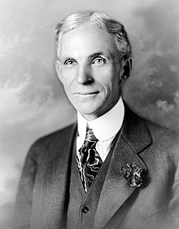
Learning outcomes
By the end of this unit, students:
understand key developments that have helped define the modern world, their causes, the different experiences of individuals and groups, and their short-term and long-term consequences
understand the ideas that both inspired and emerged from these key developments and their significance for the contemporary world
apply key concepts as part of an historical inquiry, including evidence, continuity and change, cause and effect, significance, empathy, perspectives and contestability
use historical skills to investigate particular developments of the modern era and the nature of sources; determine the reliability and usefulness of sources and evidence; explore different perspectives and interpretations; and use a range of evidence to support and communicate an historical argument.
Henry Ford

Slide 8

Historical skills
Chronology, terms and concepts
Cause and effect
Continuity and change
Use historical terms
Historical questions and research
Research questions and notetaking
Collect information from a range of sources
Reference all sources using a bibliography
Analysis and use of sources
Analyse sources to identify and interpret evidence from history
Perspectives and interpretations
Evaluate different interpretations of the past
Explanation and communication
Writing skills
Essay
Source analysis
Exam

Slide 9
Consider the impact of the following forces:
Ideas
Social/cultural
Economic
External forces/international relations
Leadership
Political

Slide 10

Capitalism: an American experience 1907-1941 (content)
the main causes of the rise of capitalism in the USA, including the expansion of the railways; post-Civil War reconstruction; immigrant labour; discovery of oil; and mass production
the role and impact of significant individuals in the period, with particular reference to Theodore Roosevelt, Woodrow Wilson, Calvin Coolidge, Herbert Hoover, F D Roosevelt, J D Rockefeller, Henry Ford
key ideas of: theories of capitalism, laissez-faire, consumerism, individualism (including ‘rugged individualism’), limited government, economic liberty, and the American Dream
the impact of WWI, the 1920s, and WWII until 1941, on American capitalism; the growth of consumerism; and the shaping of American values, for example, film and fashion, prohibition and the ‘Jazz Age’
the causes of the Great Depression, the consequences for different groups and the effectiveness of political responses, including the New Deal, and the impact on capitalism
the impact of capitalism on different groups within American society and the aims and beliefs of different groups, for example, African Americans, urban workers, rural workers, immigrants, industrialists, and members of Indian Nations; and the consequences of divisions
the significance of capitalism in this period, including a comparison with other key economic ideologies, in particular, communism
US propaganda poster WW1

Slide 11
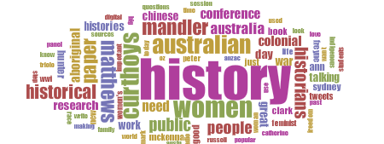
Key terminology

Slide 12

Sources/evidence
Anything that can be used to investigate the past. There are two types of sources:
Sources that come from the time being investigated are called primary sources.
E.g. coins, human remains, tools, letters, photographs.
Sources produced after the time being investigated are called secondary sources.
E.g. textbook, documentary, film.
Once a historian uses a source to answer a particular question, it becomes evidence.

Slide 13
Significance
Significance is the importance that is assigned to particular aspects of the past.
E.g. an event or issue or the contribution of an individual or group.

Slide 14
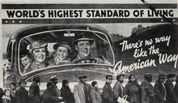
Contestability
Interpretations of the past that are open to debate.
Historians may have different opinions and perspectives about different events or things of the past, therefore, these are contested.

Slide 15
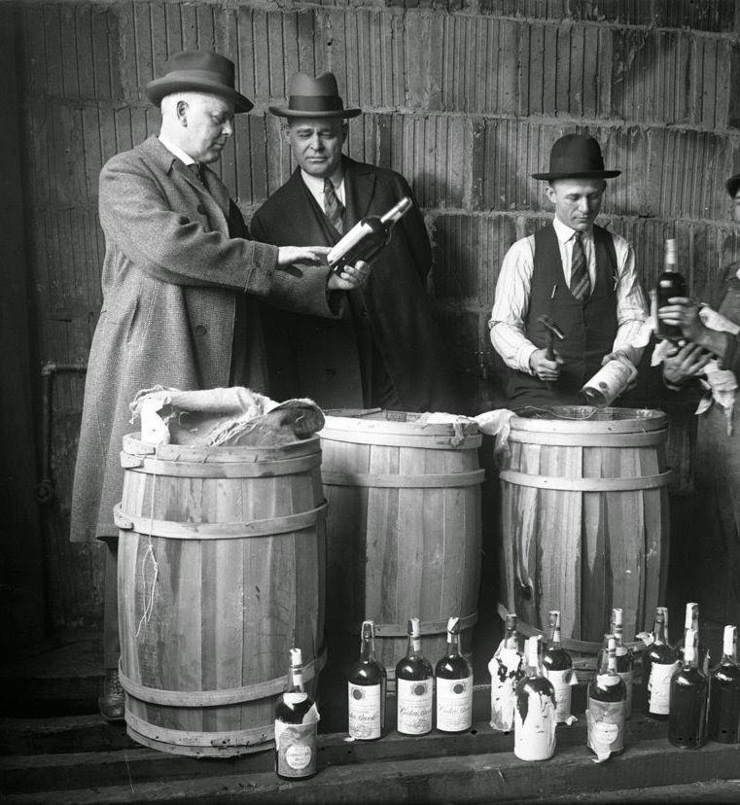
Perspectives
A person's perspective is their point of view, the position from which they see and understand events going on around them.
People in the past may have had quite different perspectives on a particular event or issue.

Slide 16
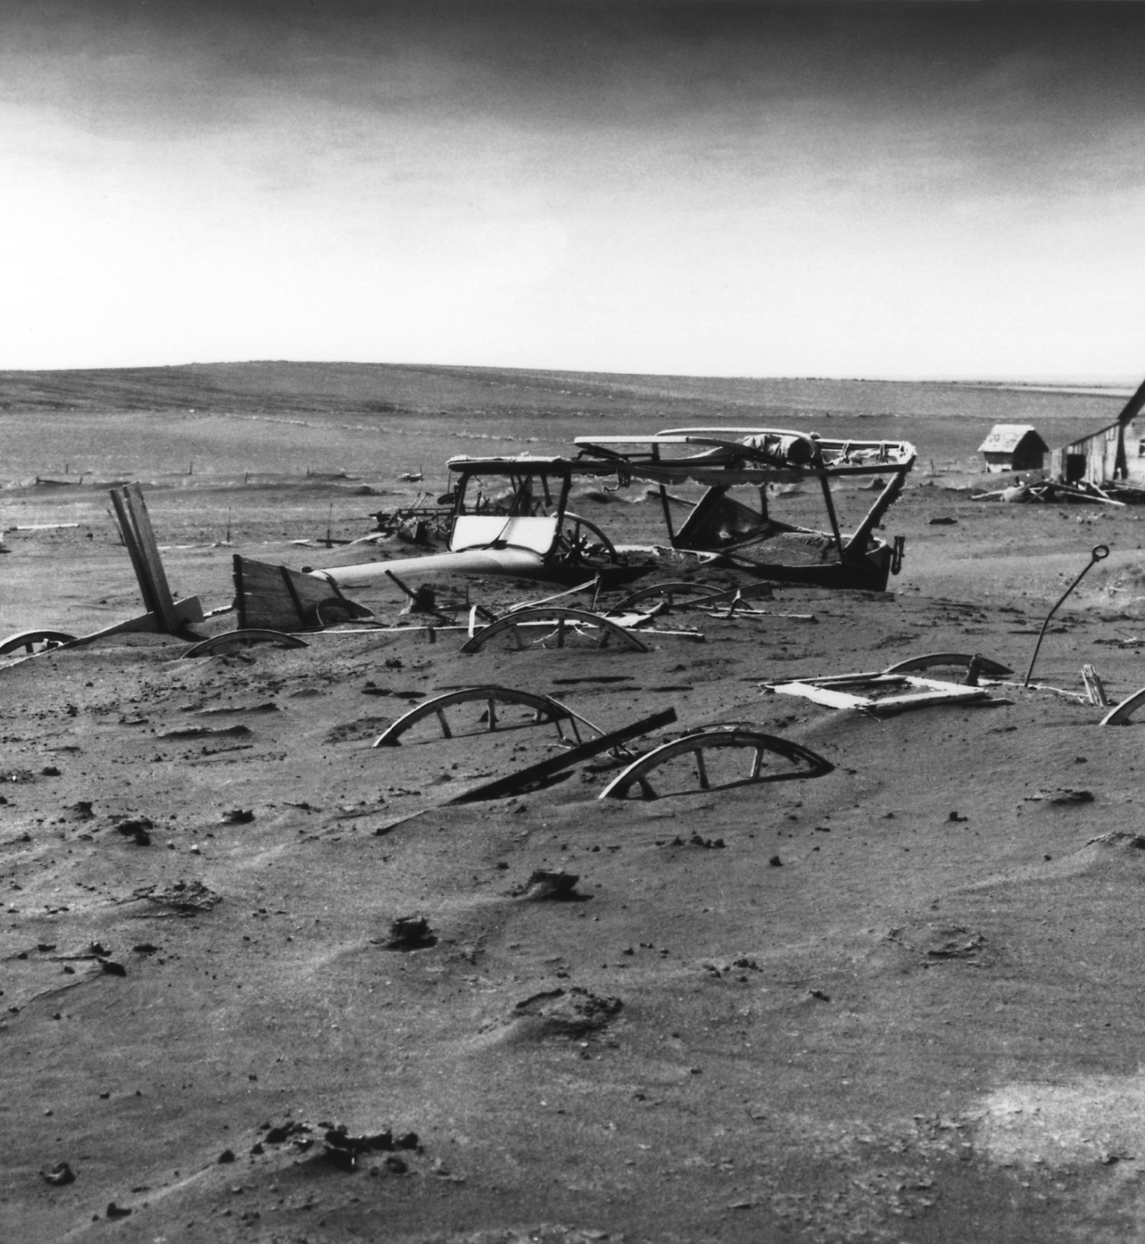
Cause and effect
Cause and effect looks at the reasons why events have occurred and the resulting consequences.
Think about cause and effect as the ‘why’ and ‘what’ of history.

Slide 17
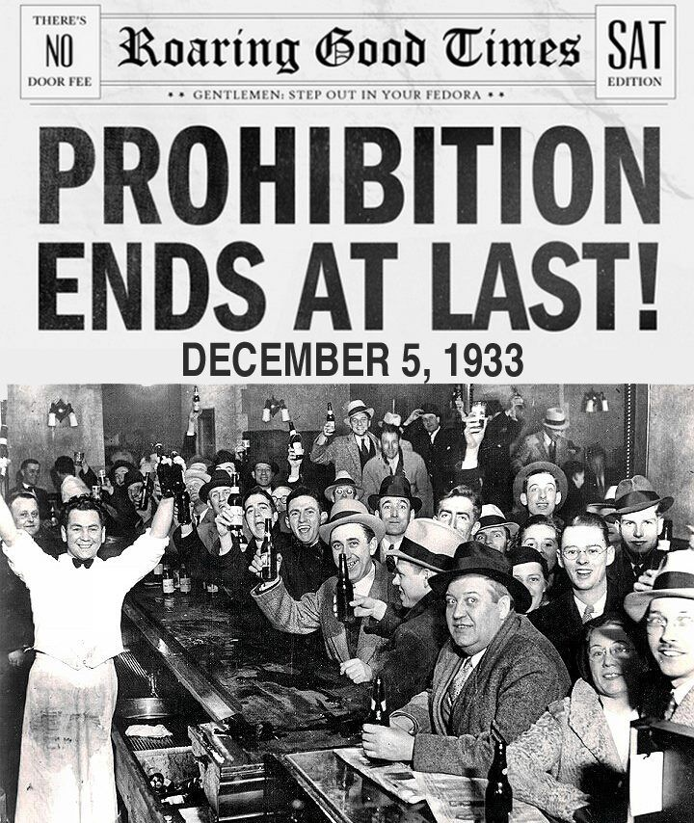
Legacy
A legacy is something that is handed down from one period of time to another period of time. An idea that will be remembered for a long time.
E.g. The Great Depression left a lasting legacy on the people and the government of the United States. Many people who lived through the era distrusted banks and no longer would buy goods using credit. They bought things with cash and stored emergency rations in their basement. Other people felt that the depression made them and the country stronger. It taught people about hard work and survival.

Slide 18
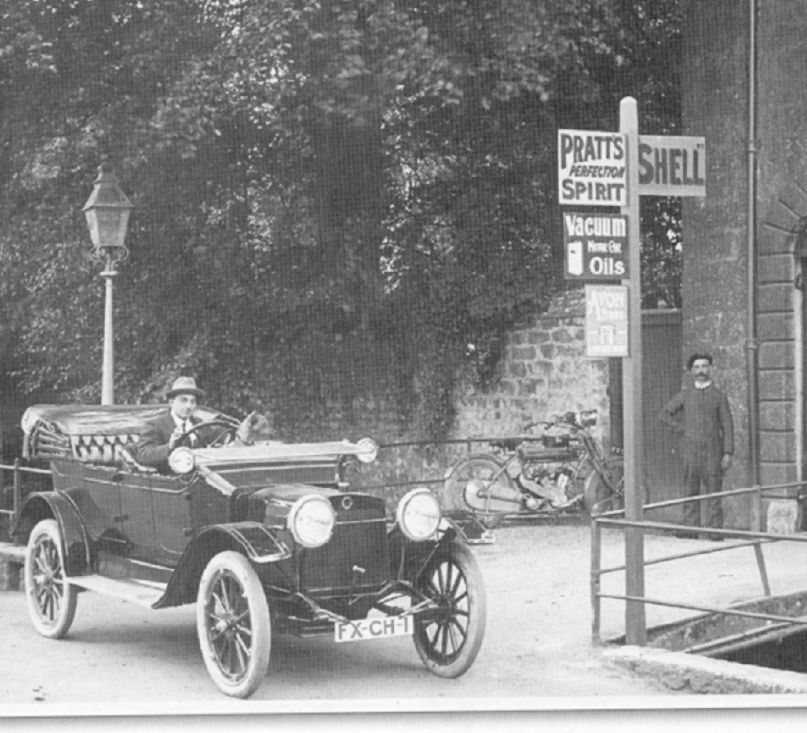
Usefulness
To decide if a source is useful you must decide if it teaches you anything!
Remember the usefulness of a source is nothing to do with it’s reliability (trustworthiness).

Slide 19
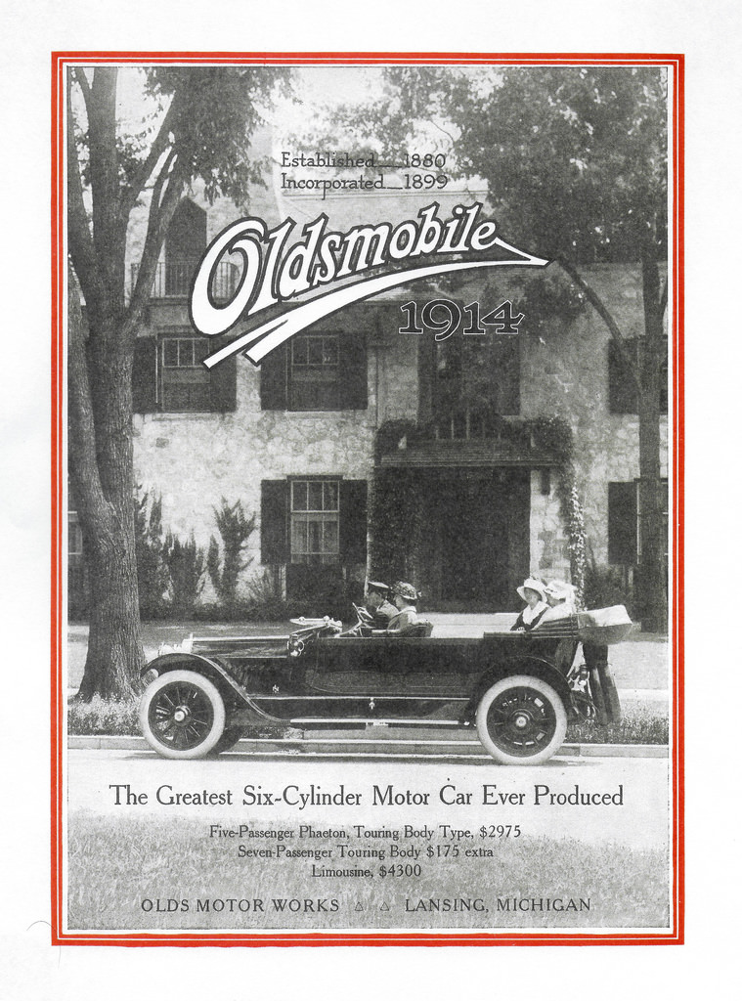
Historical context
What?
When?
Where
Who?
Cause?
Effect?

Slide 20
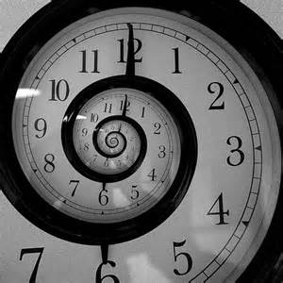
Timeline – use these significant dates and events to create a timeline of the period of study (they are not in chronological order)
1907 – start of period of study
1914 – WW1 begins
1919 – WW1 ends
1941 – end of period of study
1860 - Republican candidate Abraham Lincoln elected president
August 18, 1920 - Women given the right to vote under the Nineteenth Amendment
1917 – USA enters WW1
January 1920 - Sale and manufacture of alcoholic liquors outlawed (Prohibition)
October 1929 – Wall Street Crash
May 8 – September 2, 1945 – Germany and Japan surrender, WW2 ends
1933 - President Franklin D Roosevelt launches "New Deal“
1941 - Japanese warplanes attack US fleet at Pearl Harbour in Hawaii; US declares war on Japan (USA enters WW2)
1929-1933 - Wall Street stock market crash of 1929 triggers what becomes known as the Great Depression
November 11, 1918 – Armistice signed, ending WW1

Slide 21
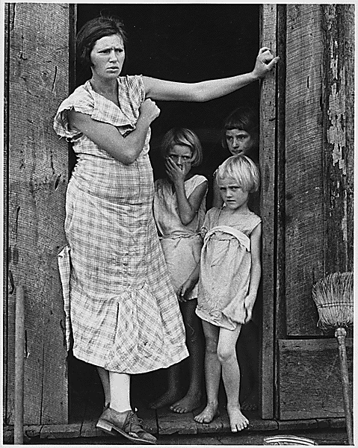
SMART Goals
Complete the worksheet given to you outlining your personal goals for this semester.

Slide 22
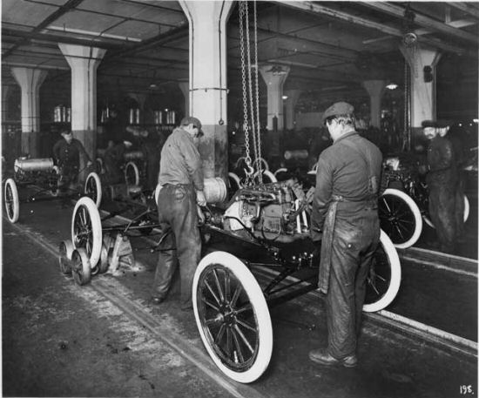
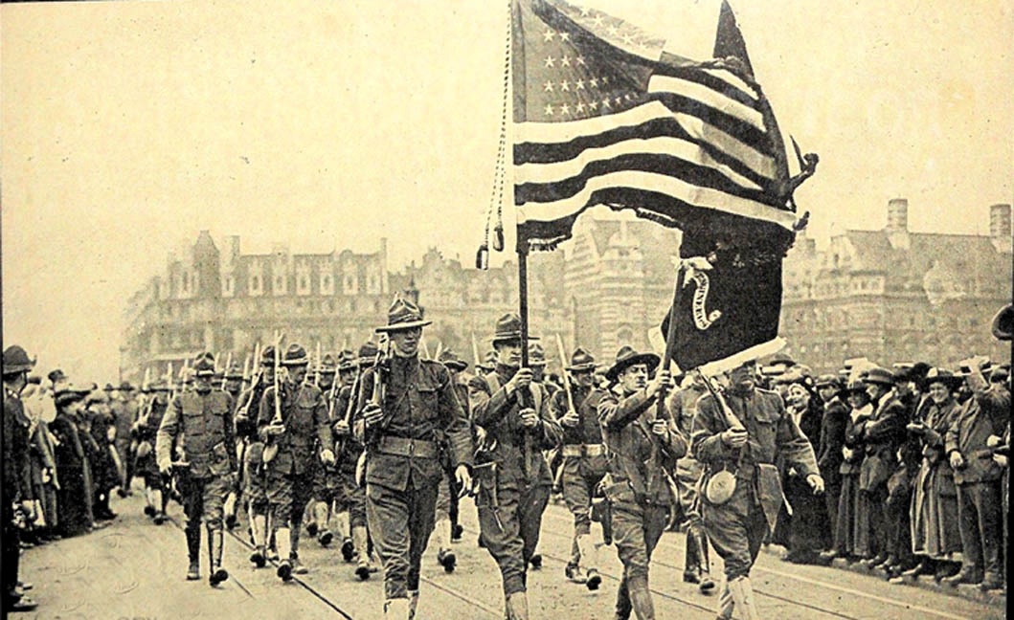
Study timetable
Complete a study timetable that will help you achieve your academic goals!

